Slide 1
DEVELOPMENT OF A NIGERIAN MUSIC COLLECTION AND RECOMMENDATION MODEL USING MACHINE LEARNING BY FALUYI TESTIMONY OLUWADUYILEMI BU19CIT1066 SUPERVISOR: MR. OYEBADE A.I JULY 2023

Slide 2
INTRODUCTION
People have considered that music is an important aspect of their lives and they listen to music, an activity they engaged in frequently.
However, the problem now is to organize and manage the millions of music titles produced by society.
A good music recommender system should be able to automatically detect preferences and generate playlists accordingly. The proposed system is to detect music plagiarism based on music similarity. The plagiarism system extracts the music from input and finds music that are close to the query music which the query has plagiarized.
A music recommendation system is a system that learns from the users past listening history and recommends songs which they would probably like to hear in the future. By using a music recommend system, the music provider can predict and then offer the appropriate songs to their users based on the characteristics of digital music that has been heard previously (Verma et al., 2021)

Slide 3
STATEMENT OF PROBLEM
Music lovers have tremendous taste of identifying their type preference, this has resulted in listening to any song that comes their way, there is therefore need to develop a music recommender model for Nigerian music lovers that will satisfy their choice, hence this study.

Slide 4
AIMS AND OBJECTIVES
The aim of the study is to develop a music recommendation model that is able to recommend music to a user based on the past listening history of a user.
The objectives of the study are:
Collect music dataset.
Develop a music recommender model for users
Evaluate the model.

Slide 5
SCOPE OF PROJECT
The project is focused on building a music recommendation system that recommends music based on the song properties.

Slide 6
LITERATURE REVIEW
Started with discussion about music and various types of music. It focus on Nigeria music.
Detailed explanation of recommender systems, ways in which recommender system can be used to recommend goods and services to users.
Music is very popular in modern life, and the amount of digital music increases rapidly nowadays. How to manage a large digital music database has arisen as a crucial problem. It is generally defined as the art of arranging sound to create some combination of form, harmony, melody, rhythm, or other expressive content.

Slide 7
LITERATURE REVIEW
Machine learning is used to teach machines how to handle the data more efficiently Sometimes, after viewing the data, we cannot interpret the pattern or information from data, thus, the use of machine learning.
Supervised machine learning: Regression and Classification
Unsupervised machine learning: Clustering
Semi-supervised machine learning
Reinforcement learning

Slide 8
LITERATURE REVIEW
Yifan Hu et al., (2008): “A Fast Incremental Matrix Factorization Approach”
The paper introduces an efficient incremental matrix factorization approach for collaborative filtering, which allows for real-time updates to the recommendation model. The method is scalable and performs well on large datasets.
The focus is primarily on collaborative filtering, and the paper does not explore other techniques like content-based or hybrid methods. Additionally, the paper does not extensively address the challenges of the cold start problem or the sparsity of user-item interaction data.

Slide 9
LITERATURE REVIEW
Meinard Müller et al., (2005): “Content-Based Music Recommendation Using Audio Signal Analysis”
The paper introduces a content-based recommendation approach that analyzes audio signal features to measure music track similarity. It leverages information directly from the music itself, making it useful for recommending tracks with similar audio characteristics.
The approach relies heavily on the availability and quality of audio signal features. It may struggle with tracks that have sparse or incomplete audio features. Additionally, this method does not capture user preferences explicitly, which limits its ability to provide personalized recommendations.

Slide 10
RESEARCH METHODOLOGY
Analysis of existing model: In order to effectively alleviate the problem of excessive data volume, this paper proposes a clustering algorithm. The user and music dimensions are clustered separately, and the user interest preference matrix in each project cluster is used to find the neighbor user of the user corresponding to the item to be evaluated. Finally, a user-based collaborative filtering recommendation algorithm is applied to each user class cluster for recommendation.

Slide 11
RESEARCH METHODOLOGY
Framework of Proposed model:
Describe the issue
Preparing the data for clustering through data processing
Selecting a clustering algorithm
Set the hyperparameters
Fit the model
Evaluate the clusters
Interpret and analyze the clusters
Iterate and refine
Apply the model

Slide 12
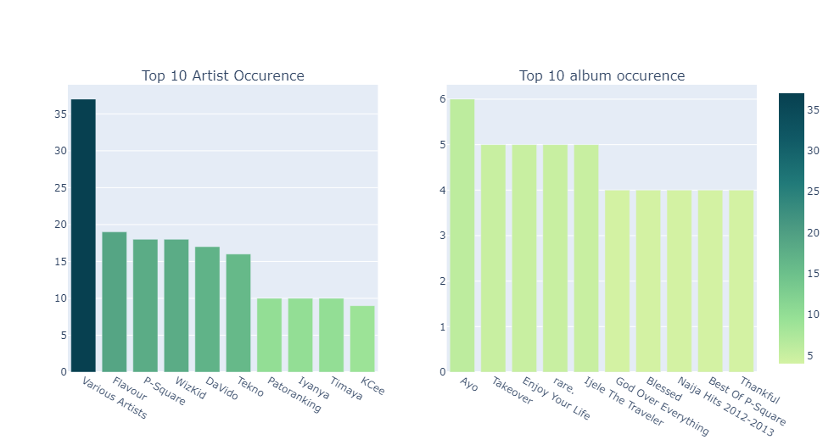
RESULTS

Slide 13
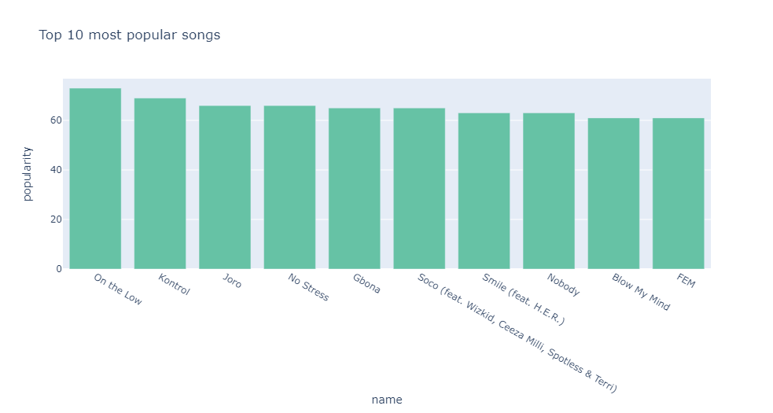
RESULTS

Slide 14
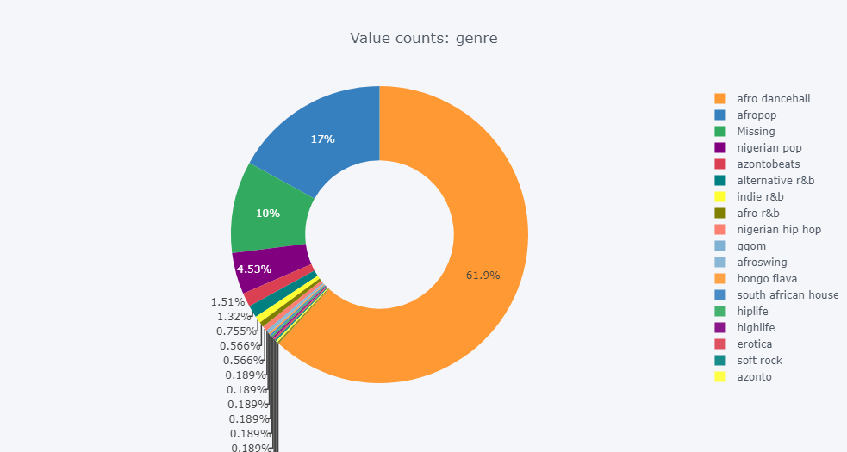
RESULTS

Slide 15
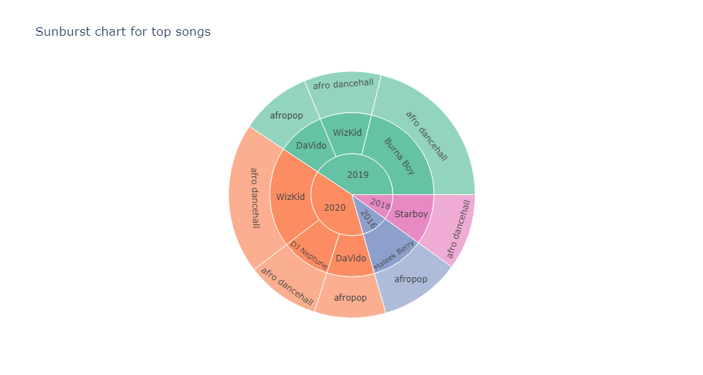
RESULT

Slide 16
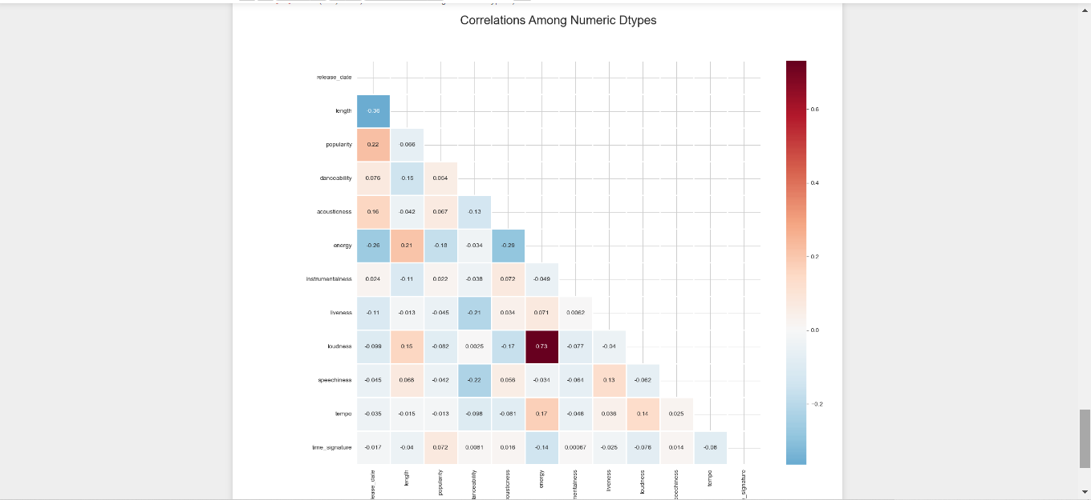
RESULTS

Slide 17
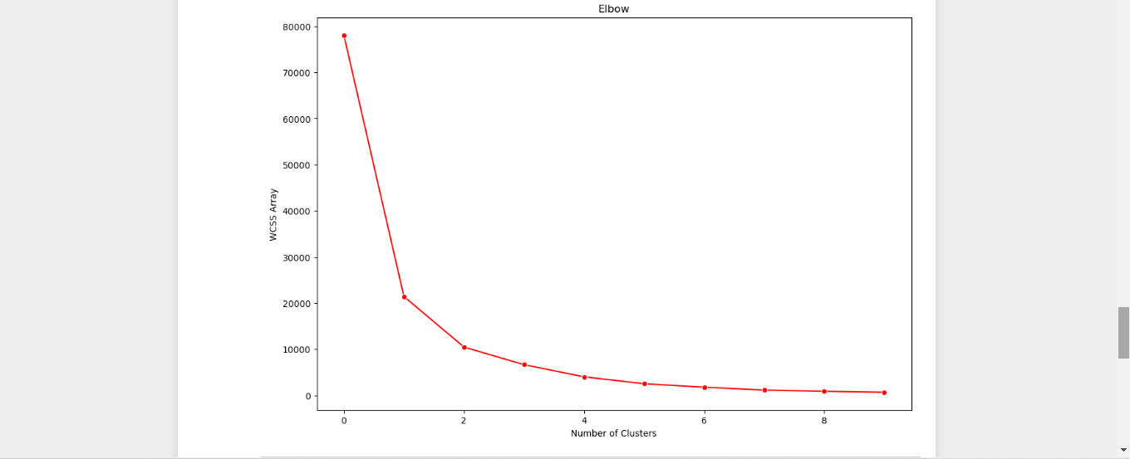
RESULTS

Slide 18
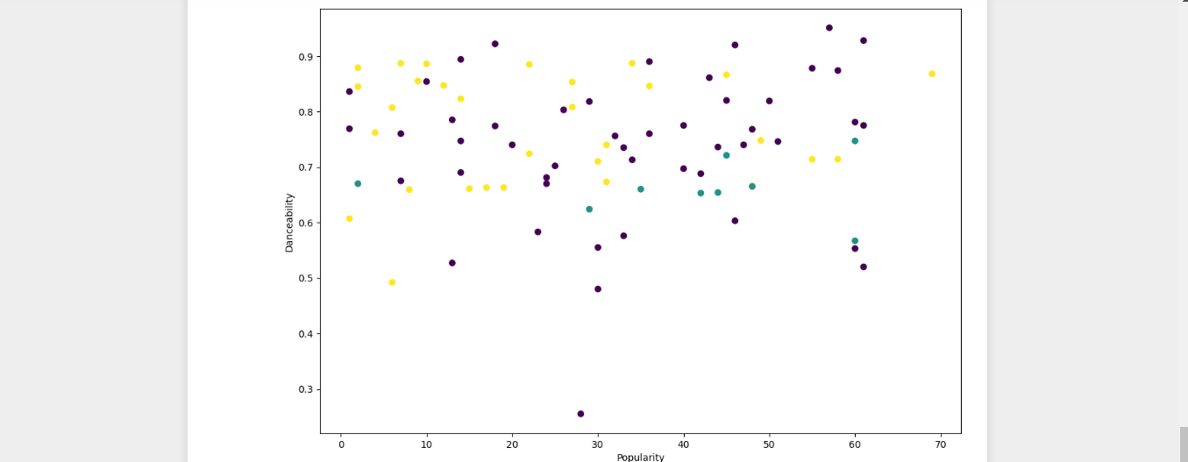
RESULTS

Slide 19
CONCLUSION AND RECOMMENDATION
In conclusion, the Nigerian music recommendation model using clustering and K-means offers a personalized and tailored music discovery experience for Nigerian music enthusiasts. By leveraging user preferences, listening behavior, and clustering algorithms, the model provides relevant recommendations of Nigerian songs, artists, albums.
The project was focused only on developing a Nigerian music recommendation model. It is recommended that:
The model is made into a functioning system.
There should be more method to use in evaluating the model.

Slide 20
THANKS FOR LISTENING

